Slide 1


Exercise test in Information Technology
http://schoolacademy.telerik.com
Test preparation for the IT Olympiad (NOIT)
Team “Melon”
Telerik online academy

Slide 2


Computer systems
Hardware questions

Slide 3
Question
Which of the following statements is NOT true for RAID controllers?
Combines two or more physical disk into a coherent unit
RAID is architecture limited to 8.64 tb. memory
Information from a file is "split" on the entire disc.
A file is never "split" across the disk

Slide 4
Answer
RAID - represents the number of independent disk combined into a logical unit. Used for securing combustion or damage to any of the hard drives.
RAID controller is not architecture limited to how much memory can contain. Recently Mac as they brought new 12tb. Pegasus.
Information:
http://store.apple.com/us/product/H5187VC/A/promise-pegasus-12tb-6x2tb-r6-raid-system

Slide 5



Software systems
Computer software

Slide 6
Question
Older file extensions and some new are indicated by three symbols (JPG, MKV, GIF), most abbreviations. From where comes this standard?
Inherited limitation of bits in the file intended to be [identifier. extension]
Clarity and organization of files
Easy to change and work on extensions
Inability of older machines due to the low RAM to process files quickly with larger extensions
That they decided on W3C consortium in 2005-th year

Slide 7
Answer
Inherited limitation of bits in the file intended to be [identifier. extension]
There is the so-called 8. 3 filetype
8 bits / name or title of the file
3 bits / characters for the name of the extension
Over time, this restriction is no longer satisfied (HTML, SDXF etc.), but continue to create and three-character abbreviations.
Information:
Wikipedia

Slide 8


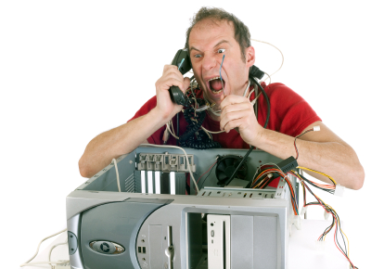
Working with computer systems and programs
Installation, usage, maintenance …

Slide 9
Question
What doesn’t make computer diagnostics?
Detects problems with the hard drive
shows the existing problems with memory
detect duplicate files
monitor the state of the processor

Slide 10
Answer
Programs for computer-aided diagnosis
Provide information about the hardware devices and installed drivers to operating system security and stability characteristics.
Reporting for problems with hardware.
Information:
http://www.lavalys.com/products/everest-pc-diagnostics/
http://download.cnet.com/windows/diagnostic-software/

Slide 11

Data transfer and notations
Channels for data transfer, measurement units, work with notations

Slide 12
Question
How to present the number 20 in hexadecimal?
24
14
10100
4F

Slide 13
Answer
The number 20 in hexadecimal is equal to 14.
Numbers in the 16th notation are 0-9 and AF, as F = 15.
Information:
http://en.wikipedia.org/wiki/Hexadecimal

Slide 14















Operating systems
Architecture, processes, users, user interface, file systems

Slide 15
Question
What is Swap Space?
Few bytes of memory that the processor uses when you need to exchange values
File in the hard drive where the operating system keeps backup copies of important files
Space on the hard disk where the operating system moves parts of memory to free space
None of these

Slide 16
Answer
None of these
Swap in and out only refer to transferring pages between RAM and dedicated swap space or swap file or scratch disk space, and not any other place on disk.
Information:
http://en.wikipedia.org/wiki/Paging

Slide 17

Software engineering
Analysis, specification, design, prototype, implementation, testing, maintenance, ...

Slide 18
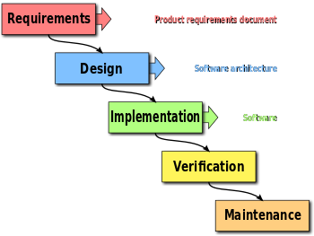
Question
This is a waterfall management. What is proven in structure is imperfect?
Different phases require too much time and resources
Programmers have no power over the other phases
Waterfall is very problematic, large companies work with Extreme programming
Possibility of errors in the completed phases and a waste of time to return by departments debugging

Slide 19
Answer
Possibility of errors in the completed phases and a waste of time to return by departments debugging
So-called "strange problem", because of the limited range of different software one can not know for absolutely all errors arising before the end of projects accumulated (Steve McConnell's book “- Code Complete “).
Information:
wicked problem - Wikipedia

Slide 20




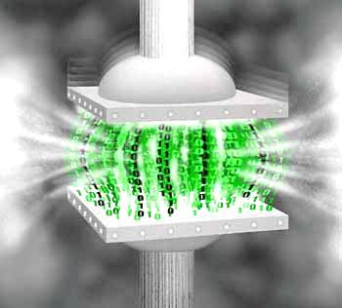




Data Compression
Compression algorithms, software for archiving and compression

Slide 21
Question
Where compression is used with linear prediction?
MPEG
JPEG
GIF
MP3

Slide 22
Answer
Compression with linear prediction is using as MPEG formats.
MPEG compression uses two types: within a frame and between frames. Coding within the frame is compressed JPEG, and between frames using linear prediction compression.
Information:
http://www.sce.carleton.ca/faculty/huang/citation1.pdf

Slide 23



Word processing
Working with word processing software, file formats, coding, text, tables, figures, ...

Slide 24
Question
Which of the following statements for BOM (byte order mark) is not true?
The byte order mark (BOM) is a Unicode character
BOM use is required
BOM can be used to determine the coding of a text file
BOМ always comes first in the file
BOM is not interpreted as part of the text by the software

Slide 25
Answer
The byte order mark (BOM) is a Unicode character used to signal the endianness (byte order) of a text file or stream. BOM use is optional, and, if used, should appear at the start of the text stream. Beyond its specific use as a byte-order indicator, the BOM character may also indicate which of the several Unicode representations the text is encoded in.
Information:
http://www.sttmedia.com/unicode-byteordermark
http://dpeeva.wordpress.com/2013/01/17/encoding-utf-8/
http://en.wikipedia.org/wiki/Byte_order_mark

Slide 26
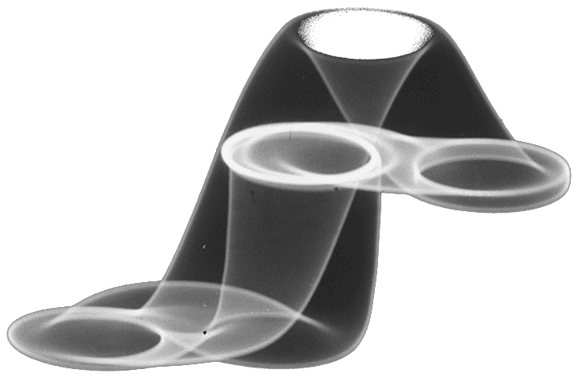



Computer graphics
Raster and vector graphics, graphic file formats, image editors, colors

Slide 27
Question
In computer graphics by mixing various basic colors we have:
color model
The color palette
additional color
mixed color

Slide 28
Answer
Upon mixing of several primary colors mixed color is obtained.
In practice, it is often necessary mixing of several primary colors, yielding color shades or color component and the hue to which the background color is called the intensity involved. The range of this intensity is 0 to 255, and the information is stored in one byte.
Information:
Color models

Slide 29






Databases
Data models, tables, relations, SQL

Slide 30
Answer
Which of the following is not a form for database normalization?
1NF - First normal form
2NF - First normal form
Trapcode normal form
Boyce-codd normal form
Domain key normal form

Slide 31
Отговор
Trapcode is a computer technology research and development company
The normalization is one of the base processes in database design. Generally speaking normalization removes repeatability and minimize excess data. The result is a better organization, a better utilization of the memory and remove anomalies in the database.
Information:
http://www.cphpvb.net/db/1876-нормализация-на-бази-данни
http://en.wikipedia.org/wiki/Database_normalization

Slide 32

Information systems
ERP, CRM, BI, BPM, FMIS, CAD/CAM, CMS, software architecture

Slide 33
Question
Which of the following programming languages ​​is not a high-level?
Pascal
Virtual Basic
Java
Assembler

Slide 34
Отговор
Assembler language is a low-level
Assembler language ( assembler ) is a programming language by which the machine language of the processor architecture is presented in a readable form for people . Machine language presents machinery operations in binary form , i.e . each machining operation is encoded with a particular combination of bits. To be readable machine code (language), these combinations of bits are replaced by symbols called unlike desktop high-level languages ​​, here we have one mapping between the presentation of the machine instruction in assembler and machine language . Assembly language is converted to machine code by the assembler , and vice versa - by disassemble mnemonic code.
Information:
http://bg.wikipedia.org/wiki/%D0%90%D1%81%D0%B5%D0%BC%D0%B1%D0%BB%D0%B5%D1%80

Slide 35


Security and data protection
Symmetrical and asymmetrical coding algorithms, cryptographic hash, digital signature, digital certificates

Slide 36
Question
What is SQL Slammer/Sapphire ?
Database management system, developed in Sweden
Plugin for MySQL
Online based application, developed by Oracle
Famous computer worm

Slide 37
Answer
SQL Slammer/Sapphire is the fastest spreading worm ever, infecting thousands of servers running Microsoft's SQL Server software every minute.
Information:
http://www.howstuffworks.com/worst-computer-viruses.htm#page=6
http://en.wikipedia.org/wiki/SQL_Slammer
http://threatpost.com/inside-story-sql-slammer-102010

Slide 38




Presentation systems
Presentation software, preparation of presentations, slides, effects, notes, colors, images, sound, video

Slide 39
Question
Which platform to create presentations using ZUI (Zooming User Interface)?
Microsoft Office Powerpoint
Prezi
Google Docs
LibreOffice Impress
Corel Presentations

Slide 40
Answer
Prezi
Prezi is a U.S.-Hungarian software company, producing a cloud-based (SaaS) presentation software and storytelling tool for presenting ideas on a virtual canvas. The product employs a Zooming User Interface (ZUI), which allows users to zoom in and out of their presentation media.
Information:
http://en.wikipedia.org/wiki/Prezi

Slide 41
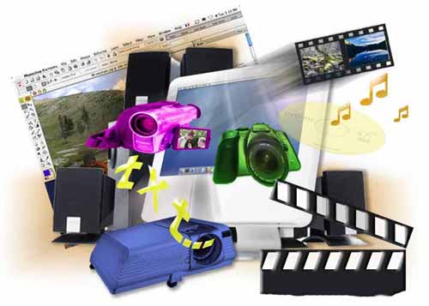



Multimedia
Software creation / processing media: audio, video, file formats

Slide 42
Question
What is the main difference between Adobe Photoshop and CorelDraw?
Adobe Photoshop is raster graphic editor, while CorelDraw is vector graphic editor
Adobe Photoshop is vector graphic editor, while CorelDraw is raster graphic editor
CorelDraw is a web browser
None of the above

Slide 43
Answer
Adobe Photoshop is a professional raster graphics editing program developed and published by Adobe Systems.
CorelDraw (styled CorelDRAW) is a vector graphics editor developed and marketed by Corel Corporation.
Information:
http://en.wikipedia.org/wiki/Adobe_Photoshop
http://en.wikipedia.org/wiki/CorelDRAW

Slide 44


Computer networks
OSI model, network models, protocols, standards, hardware

Slide 45
Question
What is the reason for migration to IPv6?
The need for higher security
The constant increase of the Internet speeds
The need for larger address space
The increase of the PON networks

Slide 46
Answer
Internet Protocol version 6 (IPv6) is a network layer protocol, it is intended to replace IPv4, which still carries the vast majority of Internet traffic.
Information:
http://en.wikipedia.org/wiki/IPv6
http://en.wikipedia.org/wiki/IPv4

Slide 47




Structure of the Internet
Internet, protocols, services, WWW, HTTP, FTP, SMTP, POP3, IMAP, WebDAV, IP, DNS, …

Slide 48
Question
How many bits comprises the length of an IPv6 address?
32
64
128
256

Slide 49
Answer
The length of an IPv6 address is 128 bits.
128 bits of the IPv6 address is represented in 8 groups of 16 bits each.
Address space is therefore 2¹²⁸ or approximately 3,4×10³⁸ addresses.
information:
http://technet.microsoft.com/en-us/network/bb530961.aspx
http://en.wikipedia.org/wiki/IPv6

Slide 50





Electronic communication
E-mail, Skype, ICQ, IRC, MSN Messenger, Yahoo Messenger, social networks, forums, ...

Slide 51
Question
What is Microsoft Exchange Server?
Server program suitable for sharing big files
Email Server program that runs on Windows Server
Server program that is used for TV streaming
None of the above

Slide 52
Answer
Microsoft Exchange Server is a mail server program, calendaring software and contact manager developed by Microsoft (runs on Windows Server).
Information:
http://en.wikipedia.org/wiki/Microsoft_Exchange_Server
http://office.microsoft.com/en-us/exchange/

Slide 53




World Wide Web (WWW)
How works WWW? The HTTP protocol, GET, POST, URL, web browser, web page, web site, …

Slide 54
Question
Which of the following methods can be used to redirect a visitor from one webpage to another.
301 redirect
302 redirect
<script type="text/javascript"> window.location = "http://donotredirect.com/"; </script>
all of the above
none of the above

Slide 55
Answer
All of the above
301 redirect is the most efficient and Search Engine Friendly method for webpage redirection.
302 redirect: “The requested resource resides temporarily under a different URI. Since the redirection might be altered on occasion, the client SHOULD continue to use the Request-URI for future requests“.
The script redirects to the site: http://donotredirect.com
Information:
http://www.webconfs.com/how-to-redirect-a-webpage.php
http://www.internetofficer.com/seo/302-redirect/

Slide 56


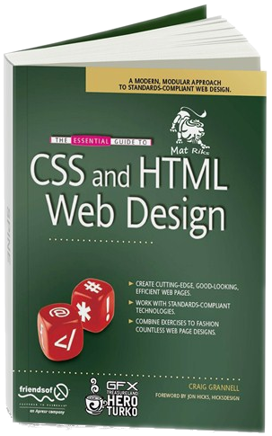

Web design, HTML, CSS
Web design, HTML, CSS, text, graphics,
references, tables, forms, ...

Slide 57
Question
The sentence: „I am working at becoming a computer programmer at Telerik.“ is part of the body in HTML file. How to format the words “computer programmer” in CSS without dividing the sentence in a new line?
<div id="format"> computer programmer </div>
<p> computer programmer </p>
<br>computer programmer</br>
<span class= "format"> computer programmer </span>

Slide 58
Answer
<span class= "format"> computer programmer </span>
<span> tag can format individual words are on one line, without having to transfer them on a new line, unlike <div>, <p> and <br>.
Information:
http://www.w3schools.com/tags/tag_span.asp

Slide 59





JavaScript
Development of scripts with JavaScript, basic JavaScript constructs, operators, objects, manipulation of DOM tree

Slide 60
Question
I need an image with id=”myimage1” to disappear 20 seconds after a visitor stays on my web page. Which of the following JavaScript functions will execute the assignment?
<script type="text/javascript"> setTimeout(function(){document.getElementById('myimage1').style.display = 'none';},20000);</script>
<script type="text/javascript"> setTimeout(function(){document.getElementById('myimage1').style.display = 'none';},30000);</script>
<script type="text/javascript"> setTimeout(function(){document.getElementById('myimage2').style.display = 'none';},20000);</script>
<script type="text/javascript“> setTimeout(function(){document.getElementById('myimage1').style.display = 'inline';},20000);</script>

Slide 61
Answer
<script type="text/javascript“> setTimeout(function(){document.getElementById('myimage1').style.display = 'inline';},20000);</script>
Value 'inline' is one that gives the functions described may be used as an 'inline' element (eg <span>).
Information:
http://www.w3schools.com/cssref/pr_class_display.asp

Slide 62
Academy of Telerik for students
?
?
?
?
?
Questions?
?
?
?
?
?
http://schoolacademy.telerik.com

